Slide 1

Auto-IA Workshop HMTM Hannover
Automatic Content Analysis
Topic Modeling
Gregor Wiedemann | g.wiedemann@leibniz-hbi.de
Media Research Methods Lab
Leibniz-Institute for Media Research | Hans-Bredow-Institut
Andreas Niekler | aniekler@informatik.uni-leipzig.de
Abteilung Automatische Sprachverarbeitung, Institut für Informatik
Universität Leipzig

Slide 2
Machine Learning
Definitions
  “[Giving] computers the ability to learn without being explicitly programmed” – Arthur Samuel
  “A computer program is said to learn from experience E with respect to some class of tasks T and performance measure P, if its performance at tasks in T, as measured by P, improves with experience E” – Tom M. Mitchell
Common foundations
  Probability Theory
  Decision Theory (making “good” decisions based on data)
  Optimization (optimize model of data based on decision objective)
independent of application domain

Slide 3
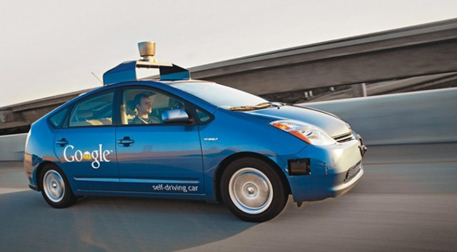
Application domains of ML
Autonomous driving
Medical diagnosis
Network security
...
Textmining and NLP:
  Linguistic preprocessing: POS-Tagging, Parsing
  Modelling Language Semantic
    category classification
    clusters of (latent) meaning

Slide 4
Machine learning for NLP
ML
supervised
(classification)
unsupervised
(clustering)
individual
proportional
VSM
probabilistic
topic models
dimensional
scaling
Naive
Bayes
SVM
ReadMe
k means
LDA
wordfish

Slide 5
Machine learning for NLP
ML
supervised
(classification)
unsupervised
(clustering)
individual
proportional
VSM
probabilistic
topic models
dimensional
scaling
Naive
Bayes
SVM
ReadMe
k means
LDA
wordfish

Slide 6
Clustering
Cluster analysis:
  „task of grouping a set of objects in such a way that objects in the same group (called a cluster) are more similar (in some sense or another) to each other than to those in other groups (clusters)“ [Wikipedia]
Motivation in content analysis:
  identifying similar / (quasi-)duplicate documents / parts of text
  splitting a collection of documents into groups
    thematic
    time periods
  identifying groups of related terms
  placing documents on an ideological scale

Slide 7
Topic Modeling

Slide 8
Topic Models
Class of probabilistic graphical models which infer semantic coherences from large text collections as latent variables
  Latent variables = topics
Background assumptions
  Bag-of-words model
  Generative process (1. document author, 2. draw topic mixture, 3. draw terms from topics → document)
2 posterior distributions
  θ : Documents = mixtures of topics
  β : Topics = probability distributions over terms
Variety of models (Blei 2012): e.g.
Latent Dirichlet Allocation (Blei et al. 2003)
Correlated Topic Models (Blei & Lafferty 2007)
Hierarchical Dirichlet Process (Teh et al. 2006)
Author-Topic Model (Rosen-Zvi et al. 2004)
...

Slide 9
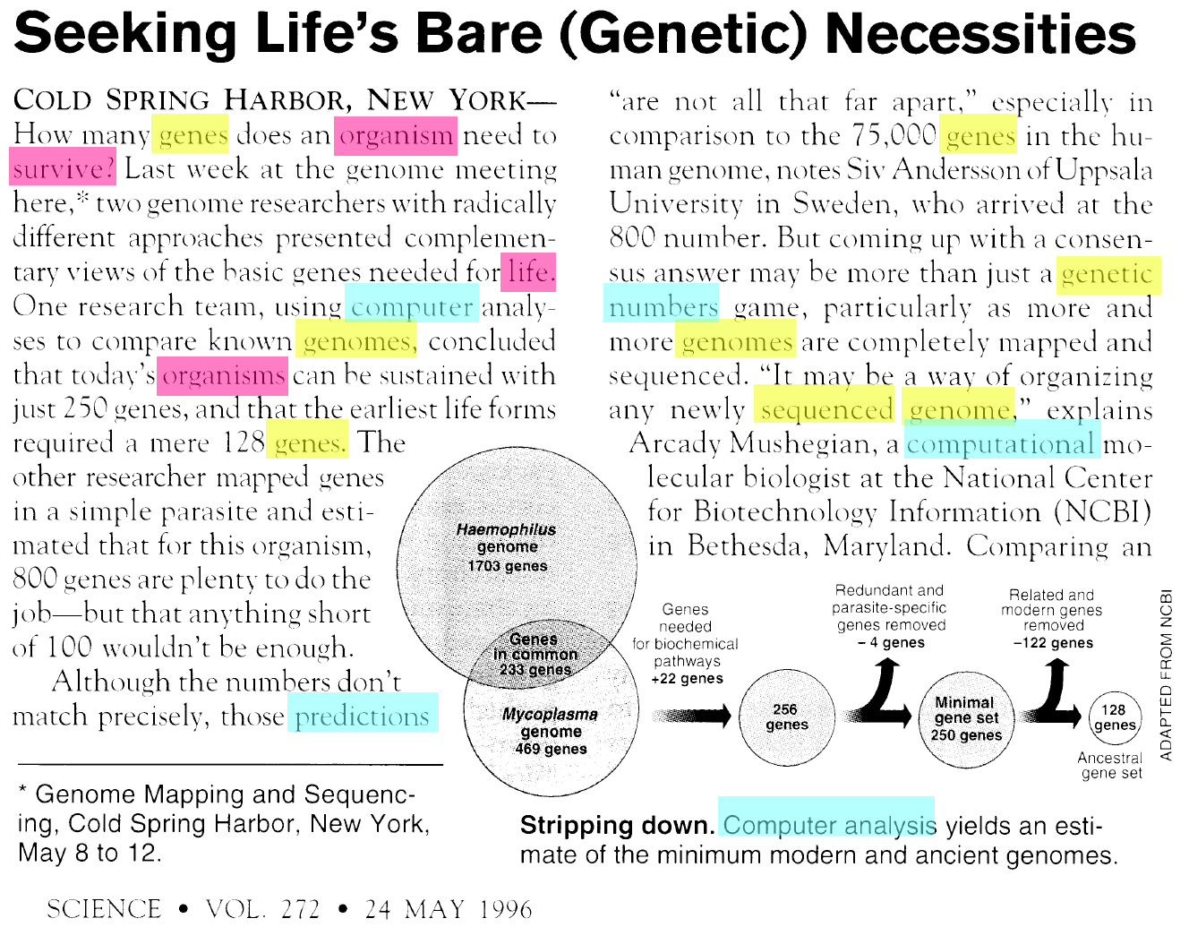
Latent Dirichlet Allocation (LDA)
Assumptions:
1. Documents are mixtures of topics
2. Topics are distributions over terms

Slide 10
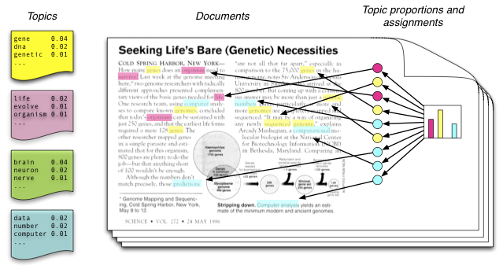
Latent Dirichlet Allocation (LDA)
Model assumptions
every topic is represented by a distribution over terms
every document is represented by a distribution over topics
generative process: for every document → draw a topic distribution → for each topic → draw a term

Slide 11
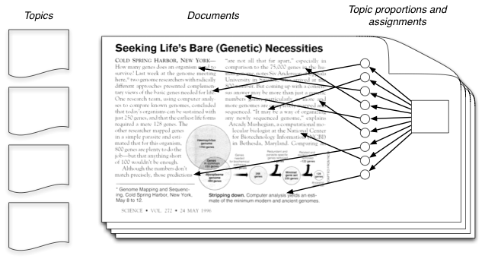
Latent Dirichlet Allocation (LDA)
in reality we see only the documents
topics as latent variables have to be inferred from the observations (terms in documents)
→ calculate the distribution: p(topics, proportions, assignments | document)

Slide 12
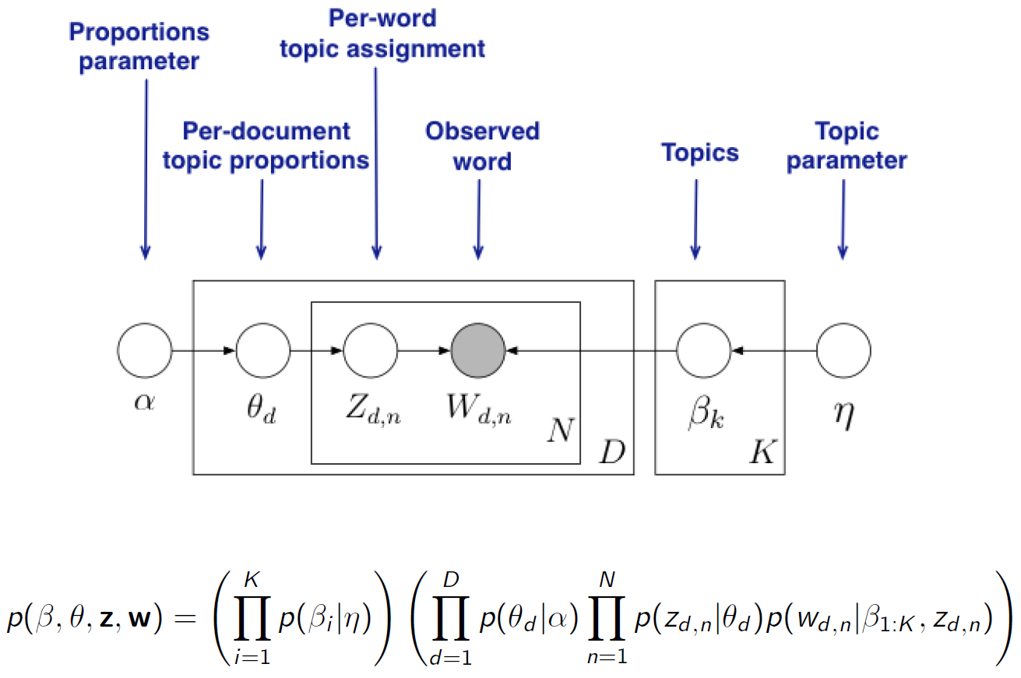
LDA as graphical model

Slide 13
LDA as graphical model
from joint distribution P(β,θ,z,w), posterior distribution can be inferred: P(β,θ,z|w)
i.e. Topic model inference resulting in
  assignments zd,n of topics to all words in each document
  distribution of topics θd in each document
  distribution of terms βk in each of the K topics
results can be used for information retrieval, time series, collection filtering, ...

Slide 14
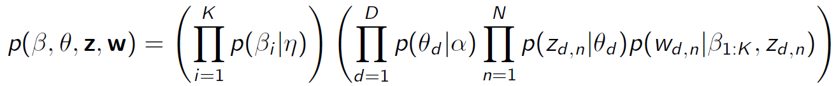
Inference
Analytically intractable → approximate solution needed
Hard task in topic modeling: computationally tractable inference on model parameters; e.g.
  Gibbs Sampling
  Variational inference
Good news: there are some fast and reliable implementations, that do the math for you :)
Crucial parameters influencing model outcomes:
  K – number of topics to be inferred
  α – prior for topic–document distributions
  η – prior for term–topic distributions
Inference is based on sampling → results are not entirely deterministic

Slide 15
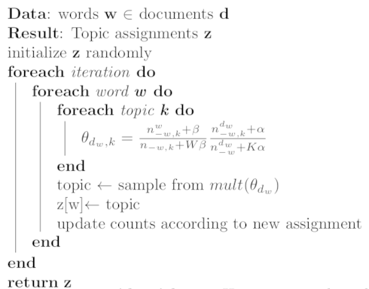
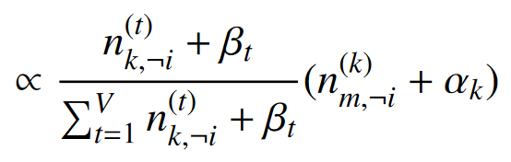
Inference – Gibbs Sampling

Slide 16
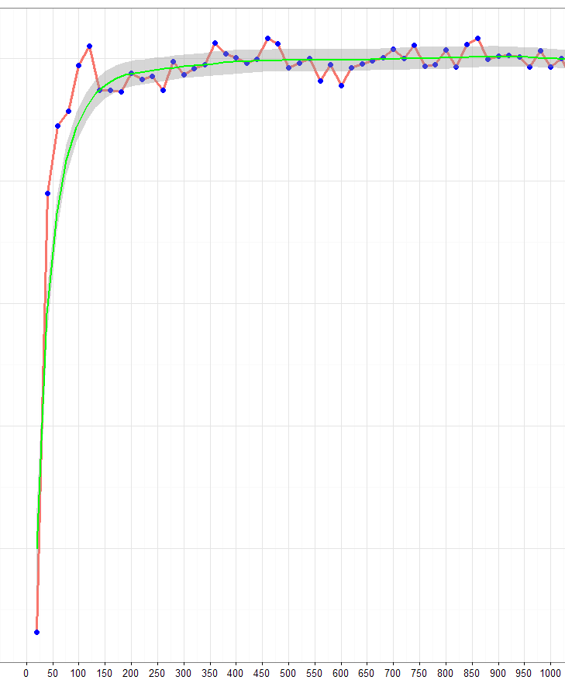
Inference – Gibbs Sampling
More interations = better likelihood of the model
Optimum almost reached at 200 – 300 iterations – This is called „burnin“ of the sampler
Likelihood does implicate the quality of the model for your research – it is an optimum w.r.t. the model assumptions
Rule of thumb: 1000 – 2000 iterations

Slide 17
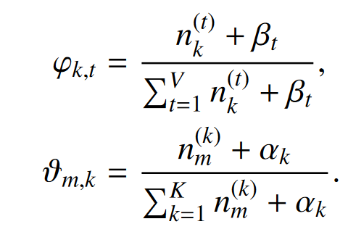
Inference – Gibbs Sampling
Gibbs algorithm samples assignments for each word
!!! Sometimes β is referenced as Φ because of the hyperparameters redundant name.
Samples must be converted to parameters θ and β by accuiring the statistics from the assigments.

Slide 18
Inference
2 mutually exclusive goals of inference process
  assign terms to as little as possible topics in one document
  assign high probability to as little as possible terms in one topic
interdependency:
  assign all terms in one document to one topic only → missing 2. goal
  assigning high probability to few terms in each topic → missing 1. goal
optimal alignment of these goals results in semantically coherent groups of terms and interpretable numbers of topics in documents
  θ =
0.1 | 0 | 0.5 | 0.1
0 | 0 | 0 | 0.2
0.1 | 0.3 | 0 | 0.1
0 | 0 | 0 | 0
β =
0.2 | 0.1 | 0.4 | 0.1
0.2 | 0.1 | 0.3 | 0.2
0.1 | 0.2 | 0 | 0.1
0.2 | 0.4 | 0 | 0.1
d documents
m Terms
K topics
K topics

Slide 19
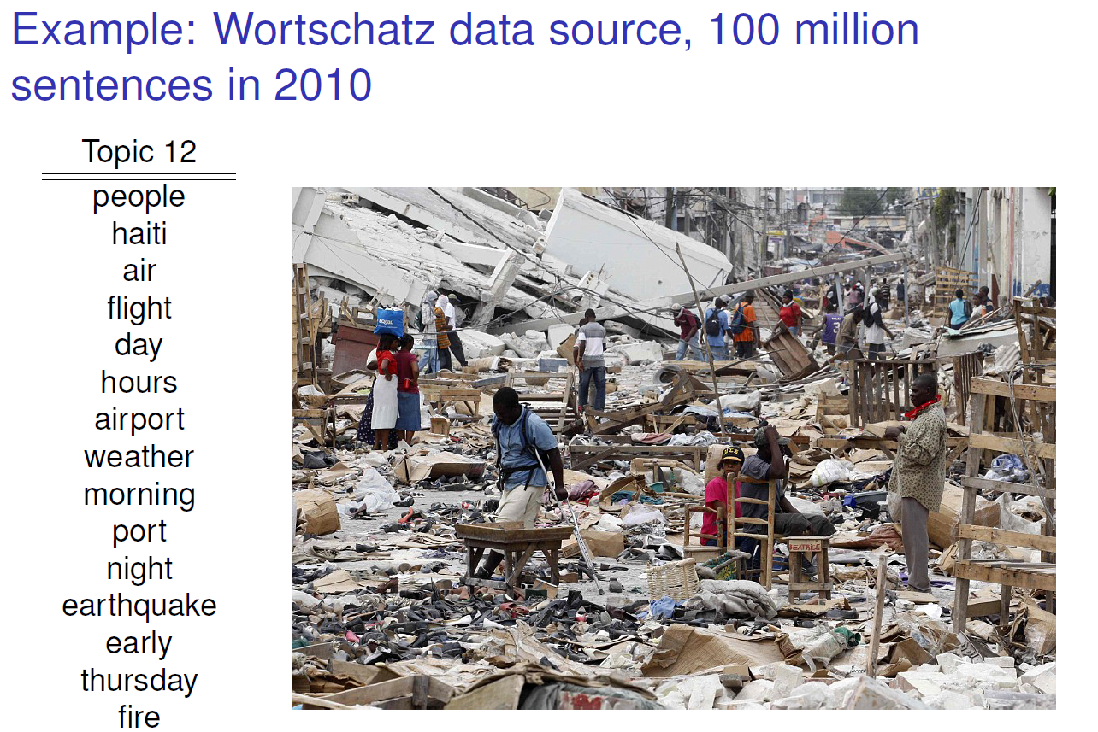
LDA examples
[Jähnichen 2015]

Slide 20
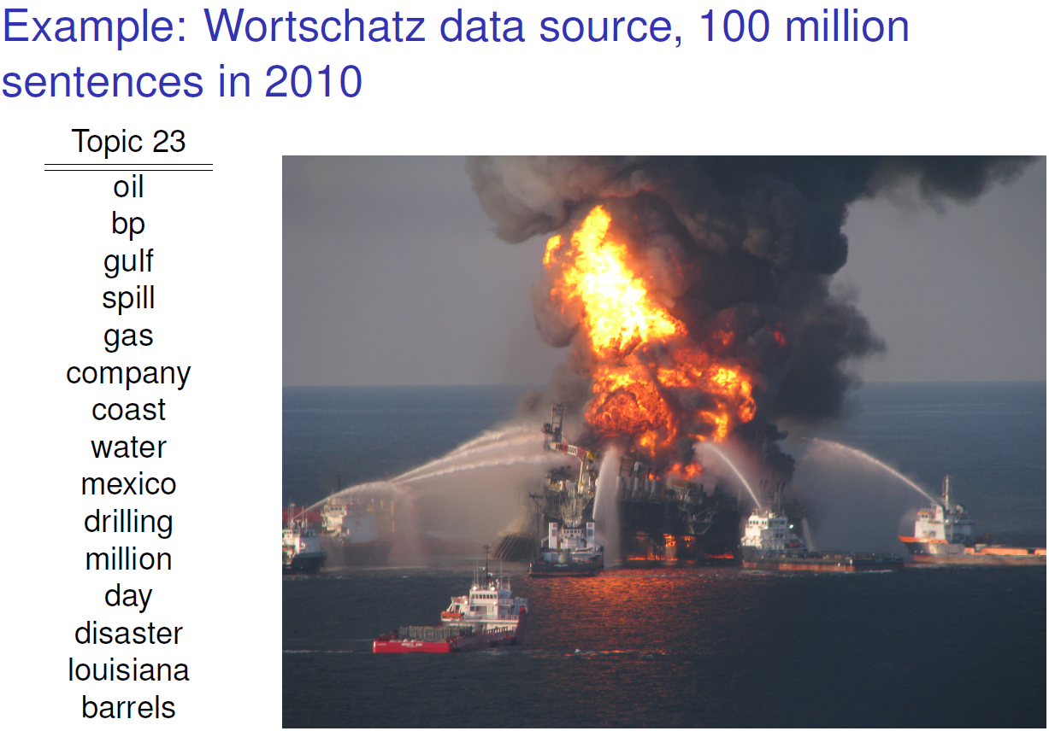
LDA examples
[Jähnichen 2015]

Slide 21
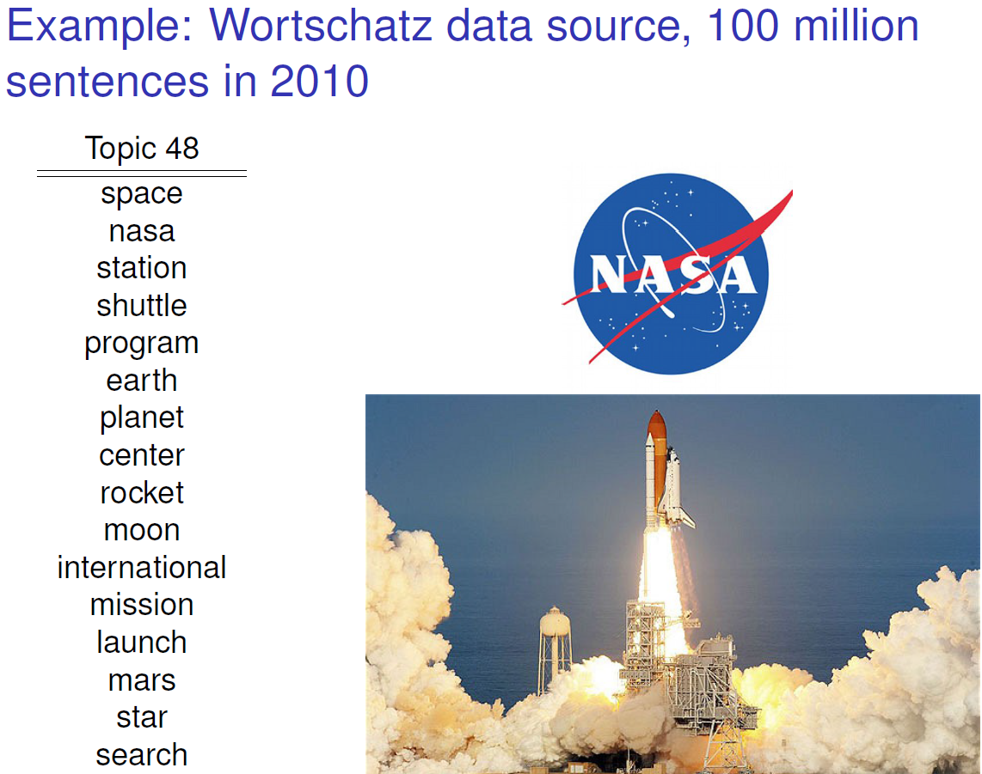
LDA examples
[Jähnichen 2015]

Slide 22
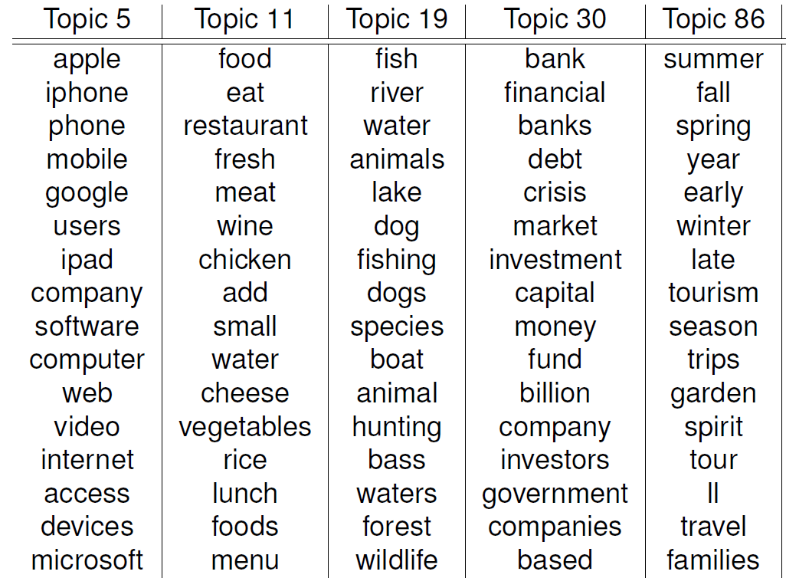
LDA examples
[Jähnichen 2015]

Slide 23
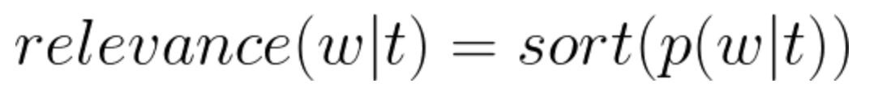
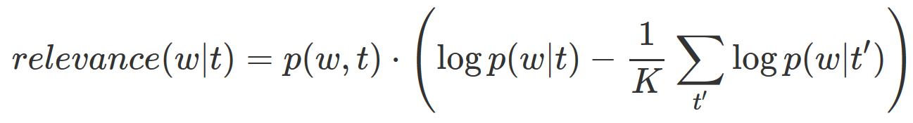
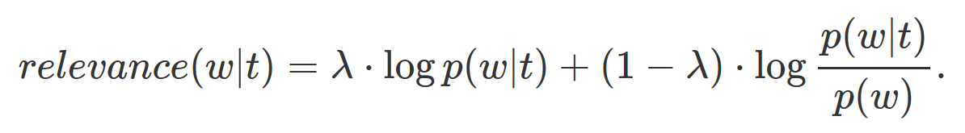
Sorting Terms
Standard Term Scoring
Scoring by Chang, J., Chang, M.J.: Package “lda”. Citeseer (2010).
Scoring by Sievert, C., Shirley, K.E.: LDAvis: A method for visualizing and interpreting topics. In: Proceedings of the workshop on interactive language learning, visualization, and interfaces. pp. 63–70 (2014).

Slide 24
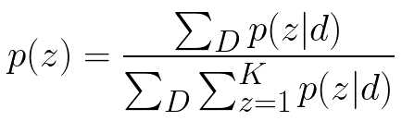
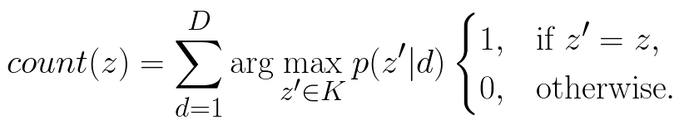
Sorting Topics
1. Approach: We sort the topics by their probability among the whole collection:
2. Approach: We count how often a topic appears as the primary topic within the documents. This method is called Rank-1.

Slide 25
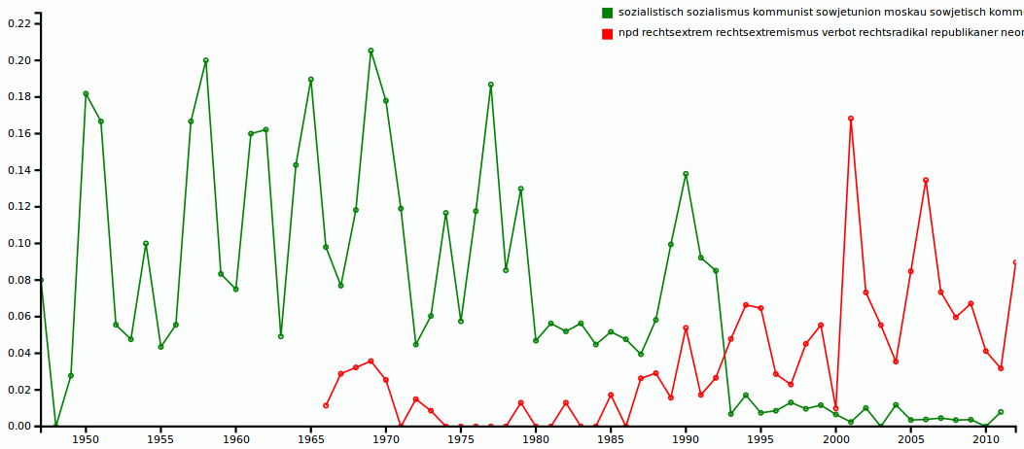
LDA examples
Time series: frequencies (relative to collection size) of documents containing
minimum 25% share of topic k (θd,k > 0.25)

Slide 26
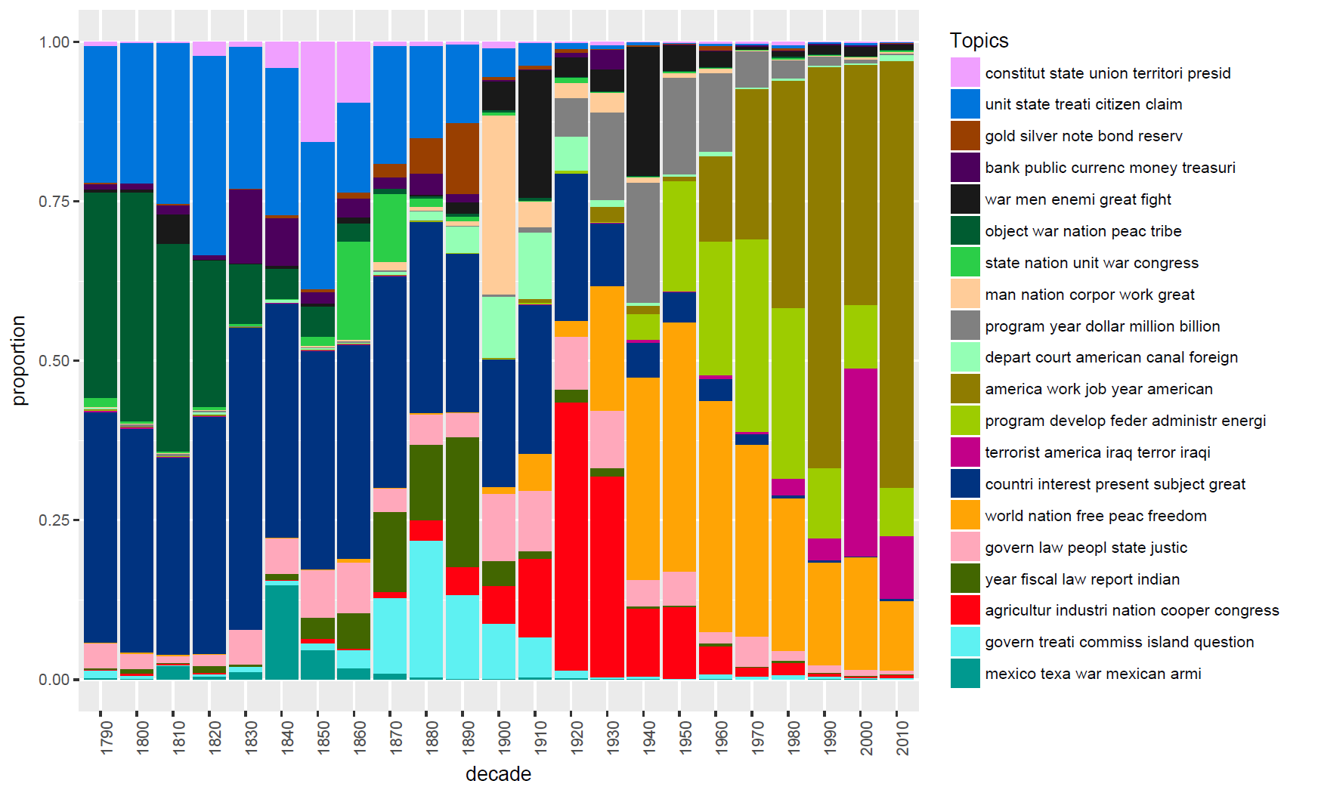
LDA examples

Slide 27
Applying topic models in CA
Topic models can be employed to
  split collections into thematic clusters
  identify documents related to certain topics
  track topic quantities over time (aggregation of document topic probabilities)
  identify similar documents based on similarity of topic distributions rather than term frequencies (cp. k-means on DTM)
  identify relevant vocabulary within a collection
Analysts need to
  choose appropriate K
  interprete resulting topics
  eventually optimize mode parameters (α, η priors)
  incorporate result data into their workflows

Slide 28
Possible alterations
Filter POS-Types: Concentrate on NN(S) / NNP(S)
Add extra vocabulary
  time stamps, categories, dictionary terms, onthology categoritzation
Initialize to predefined assignments – forced topic id‘s for words
  seeded initialization
  initialization by co-occurrence clusters of words
Problem: Inner document statistics are dependent on empirical data within the document - Short documents cannot be modelled very well
  Twitter: Try to concat tweets of the same user or hashtag to longer artificial documents – depends on the intendet topical structures

